Slide 1
Expense Management System
Team Members:
Sri Nithya Loka
Bhargavasai Bandi
Imran Shaikh
Satyam Mahajan
Jigar Prajapati
.
Mentor: Mr. Suramya Biswas

Slide 2
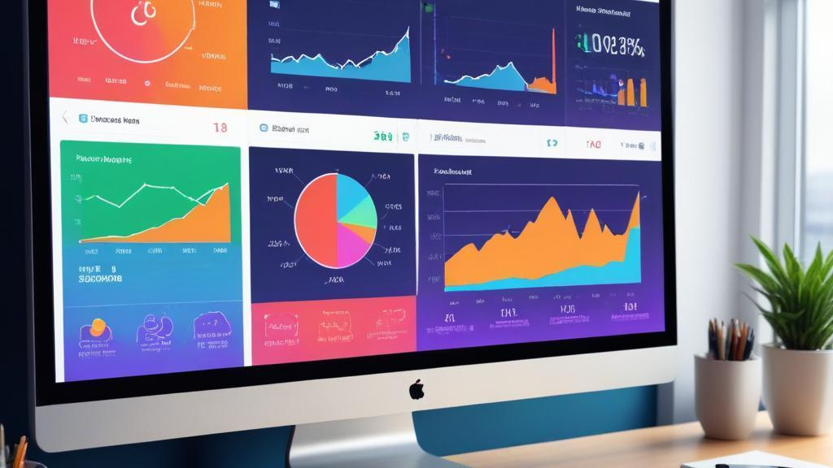
Introduction
The Expense Management System is a digital platform for tracking and managing expenses efficiently. It allows users to categorize transactions, set budgets, and generate insightful reports. With a user-friendly interface and secure access, it helps maintain financial stability and prevent overspending.

Slide 3
TECHNOLOGIES USED
FRONTEND -> REACT JS, BOOTSTRAP
BACKEND -> JAVA, SPRINGBOOT3, SPRING DATA JPA, SPRING SECURITY
DATABASE -> MYSQL8
TOOLS -> ECLIPSE IDE, MICROSOFT VS CODE

Slide 4
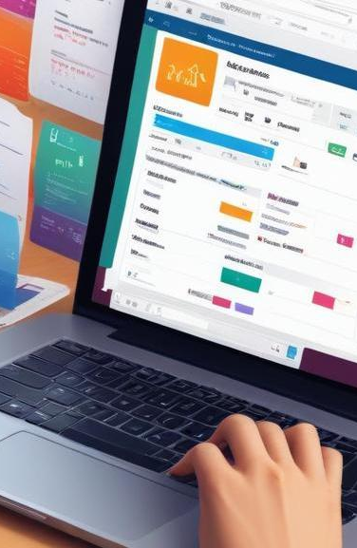
MODULES TO BE IMPLEMENTED
1️⃣ User Module – Manages user authentication, roles, and access control.
2️⃣ Expense Module – Enables users to add, update, and track expenses.
3️⃣ Category Module – Organizes expenses into predefined/custom categories.
4️⃣ Customer Module – Manages customer details, registration, expense entry and expense tracking.
5️⃣ Report Module – Generates analytical reports for expense tracking.

Slide 5
Features of Project
1. User Management
Secure user registration and login
Role-based access control (Admin & Customer)
Profile customization and management
2. Expense Tracking
Add expenses with details (amount, category, date, description)
Modify or delete expense entries
Filter and view expenses based on date, category, or amount
3. Customer Management
Add, update, and maintain customer details
Track customer status (Active, Regular, or Archived)
4. Category Management
Create, edit, and delete expense categories (e.g., Food, Travel, Rent)
Organize expenses by assigning them to relevant categories
5. Report Generation
Generate detailed expense reports (daily, weekly, monthly)
Export reports in multiple formats

Slide 6
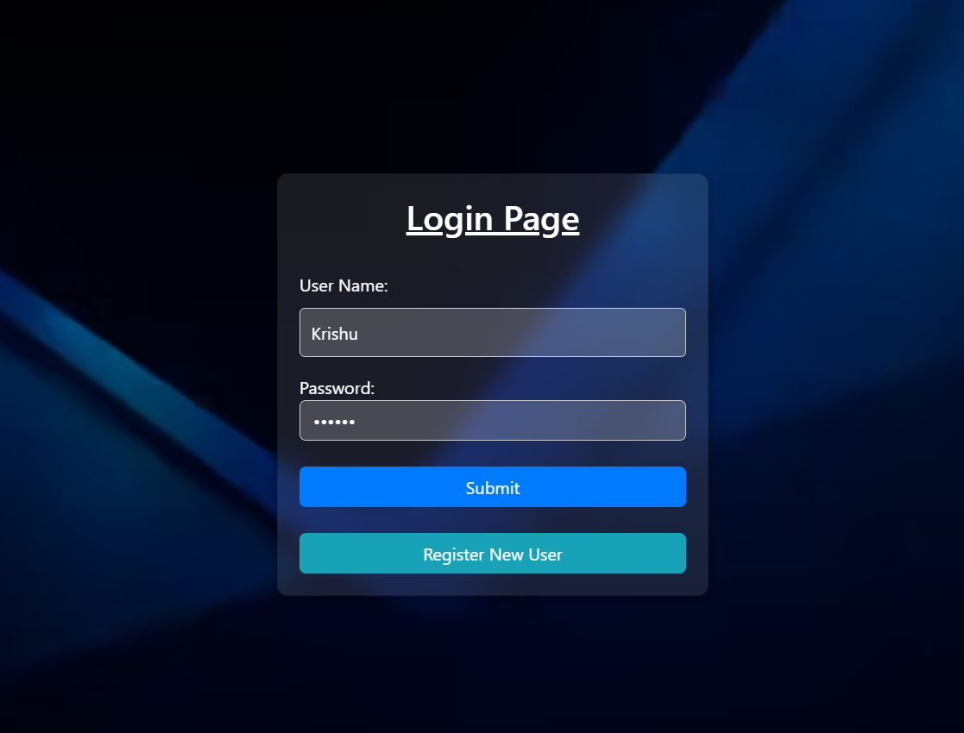
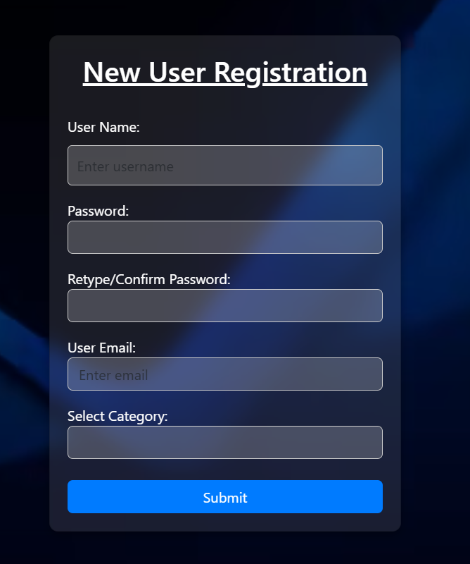
Outputs

Slide 7
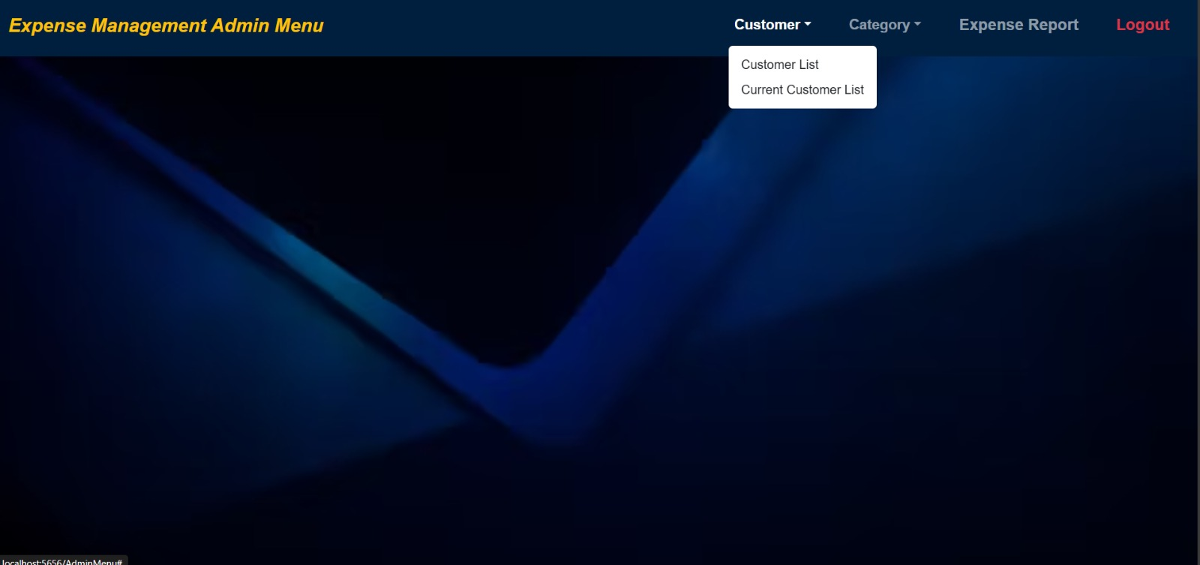
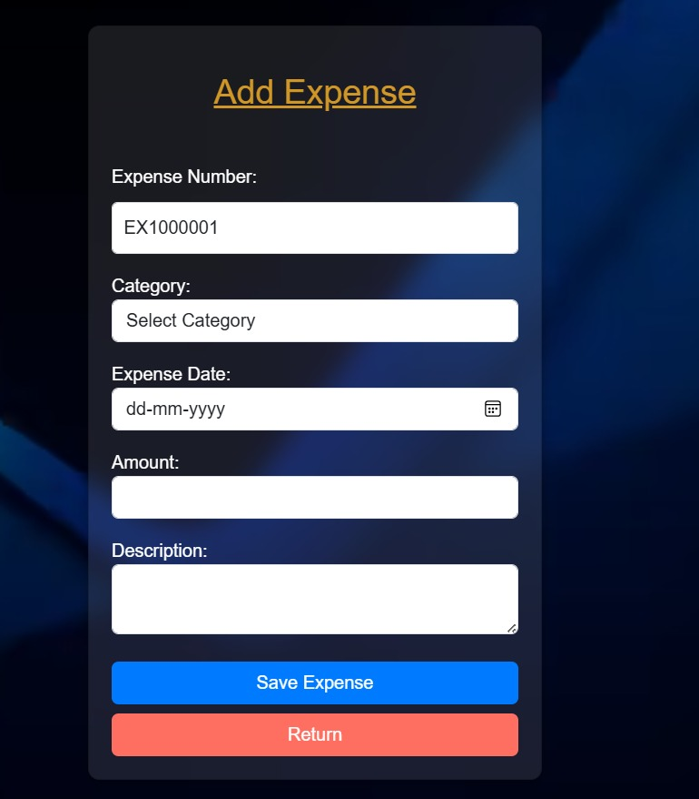
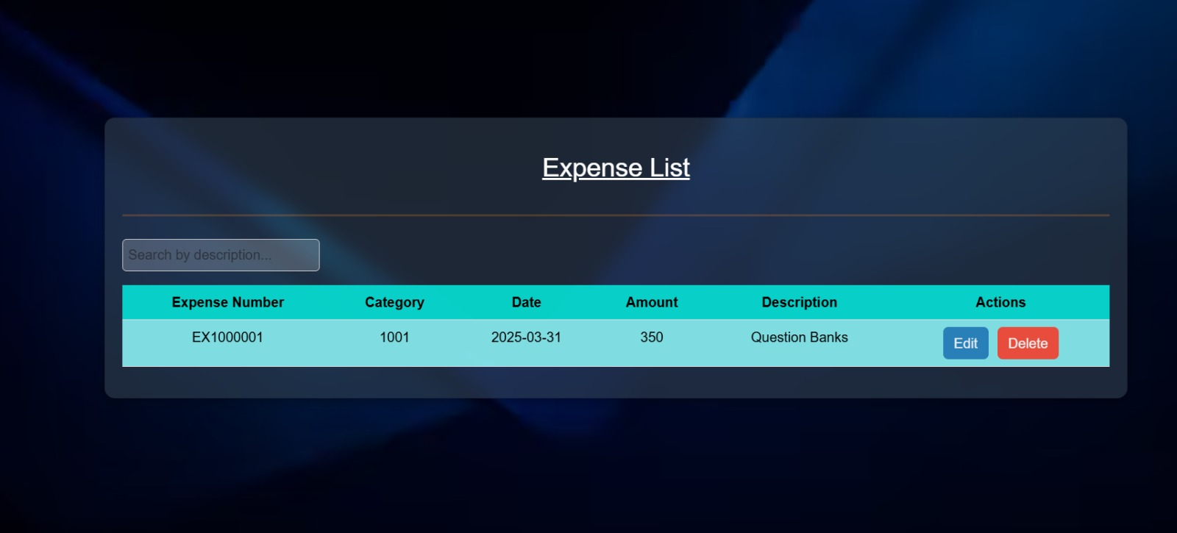

Slide 8
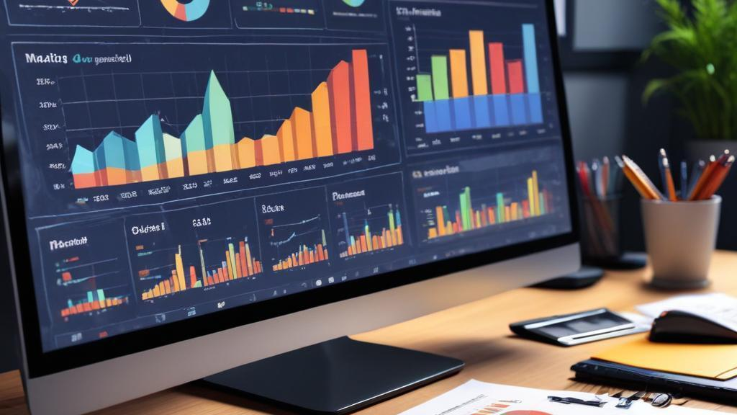
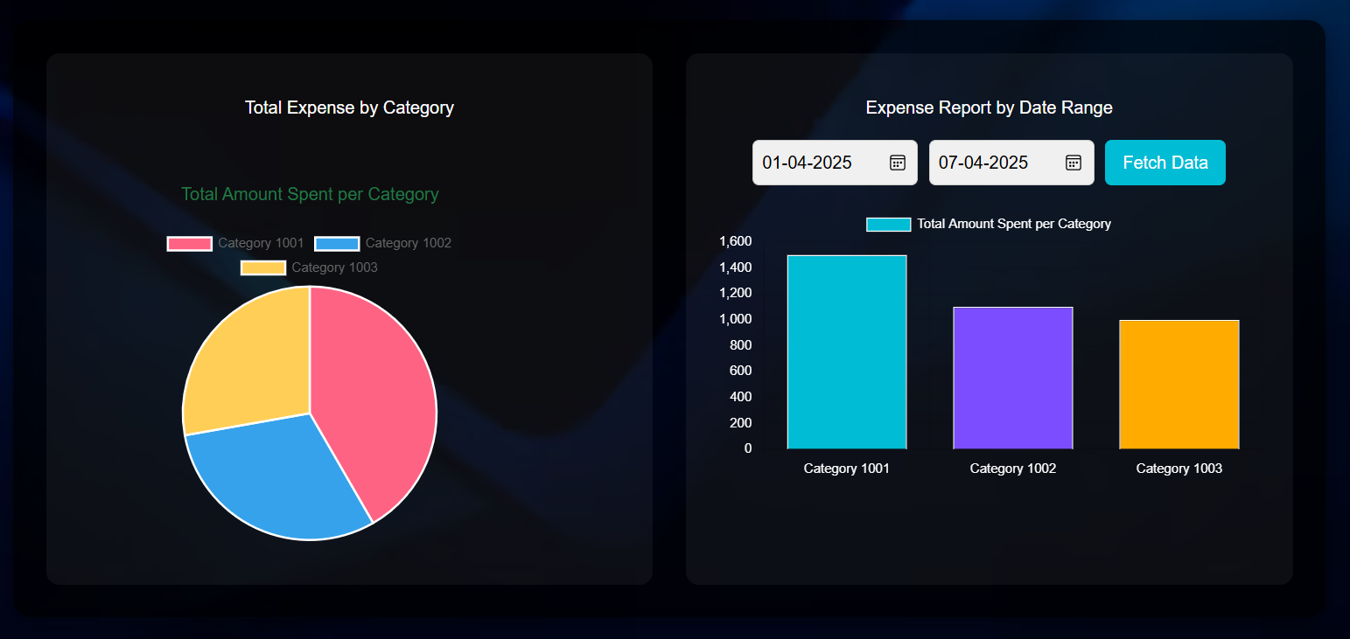
Generating Reports and Analytics

Slide 9
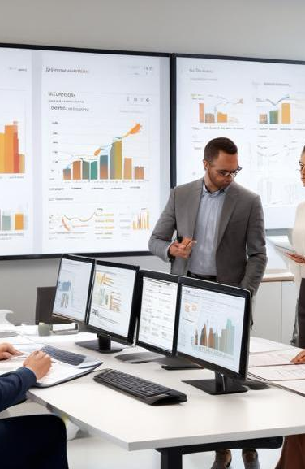
Conclusions
This project efficiently records customer details, their expenses, and categorized spending. It helps users track their financial activities, set budgets, and analyze spending patterns. By providing detailed insights and organized records, the system enhances financial management and promotes better budgeting decisions.

Slide 10
Future Scope
1️⃣ AI-Based Expense Categorization – Uses AI to automatically classify and analyze expenses.
2️⃣ Mobile App Integration – Provides users with on-the-go access via a mobile application. 3️⃣ Multi-Currency Support – Allows transactions and reports in different currencies.
4️⃣ Budgeting & Forecasting – Helps users set budgets and predict future expenses.

Slide 11
Thank you!
Thnk you!

